Slide 1

Trailer

Slide 2


We are #1
Project Hope
Notes:
We are team we are number #1 and this is our project, Hope

Slide 3
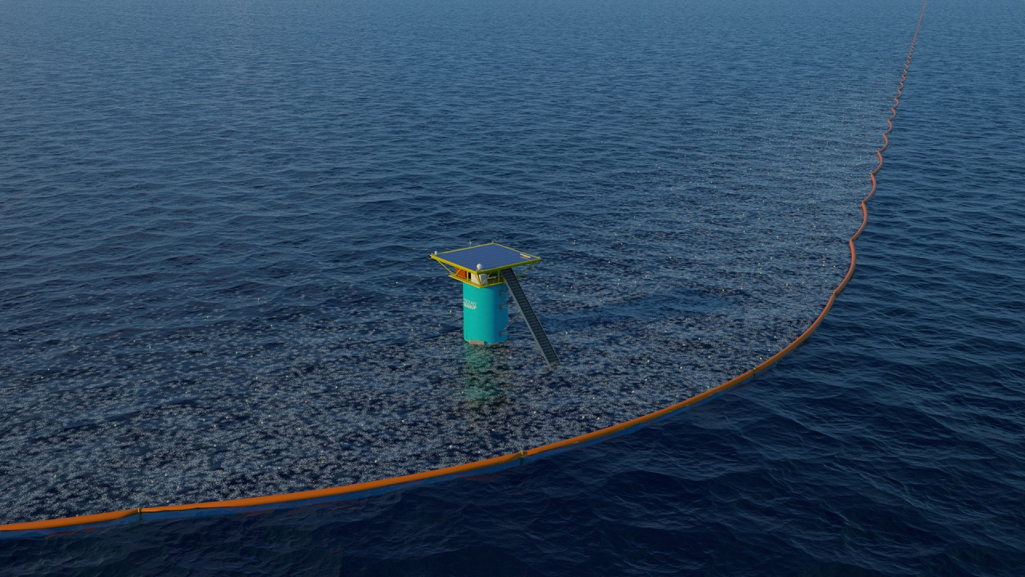

Notes:
Ocean cleanup is a Rotterdam based organization dedicated to cleaning up the great garbage patches, currently deploying in the biggest and most researched one: the north atlantic patch

Slide 4
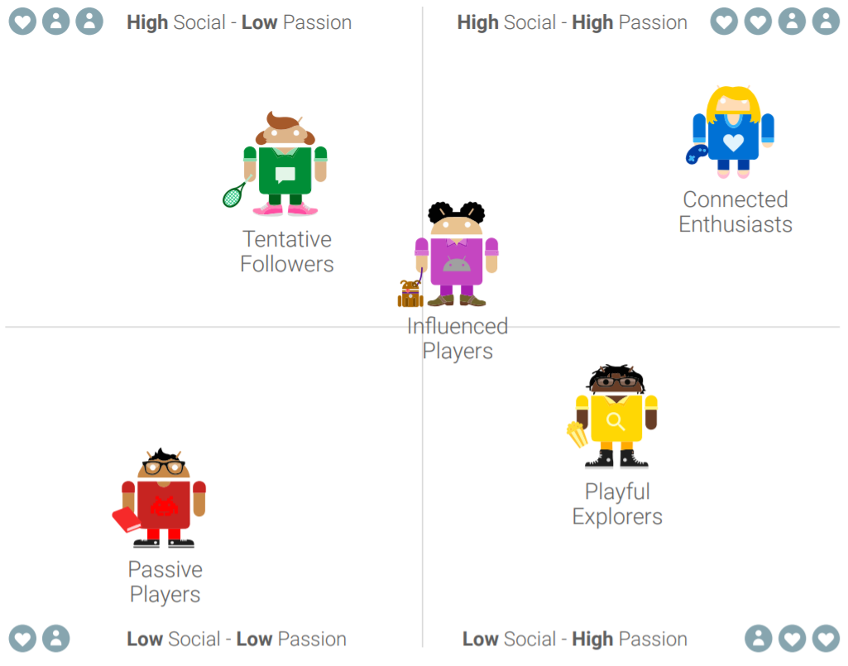
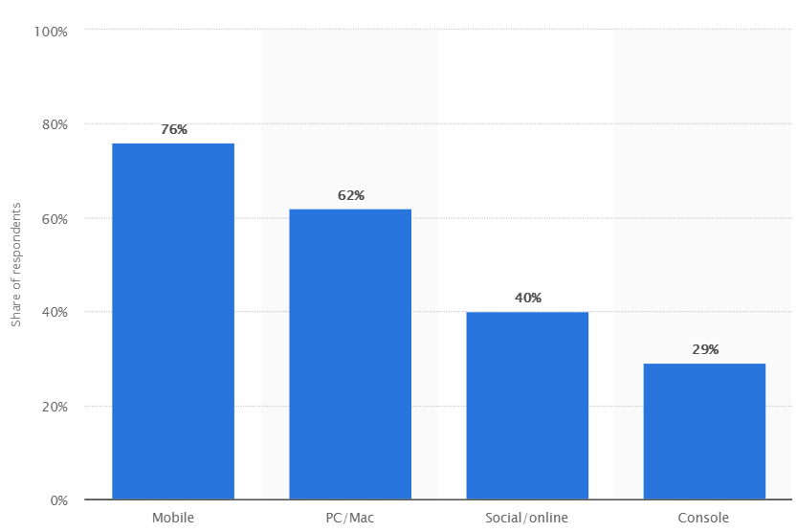
User Research
Notes:
Biggest unity 3d product is mobile games and google categorized player types of which we chose 2 to make a fun game for

Slide 5
Last Week
This Week
VS
Game is too slow
Items to pick up are not clear
Gyroscope movement
More interesting UI elements
More variety
More feedback from the UI
Tutorial
Change the particle system
Notes:
User testing and then mention for each thing what we did to fix it, be concise

Slide 6
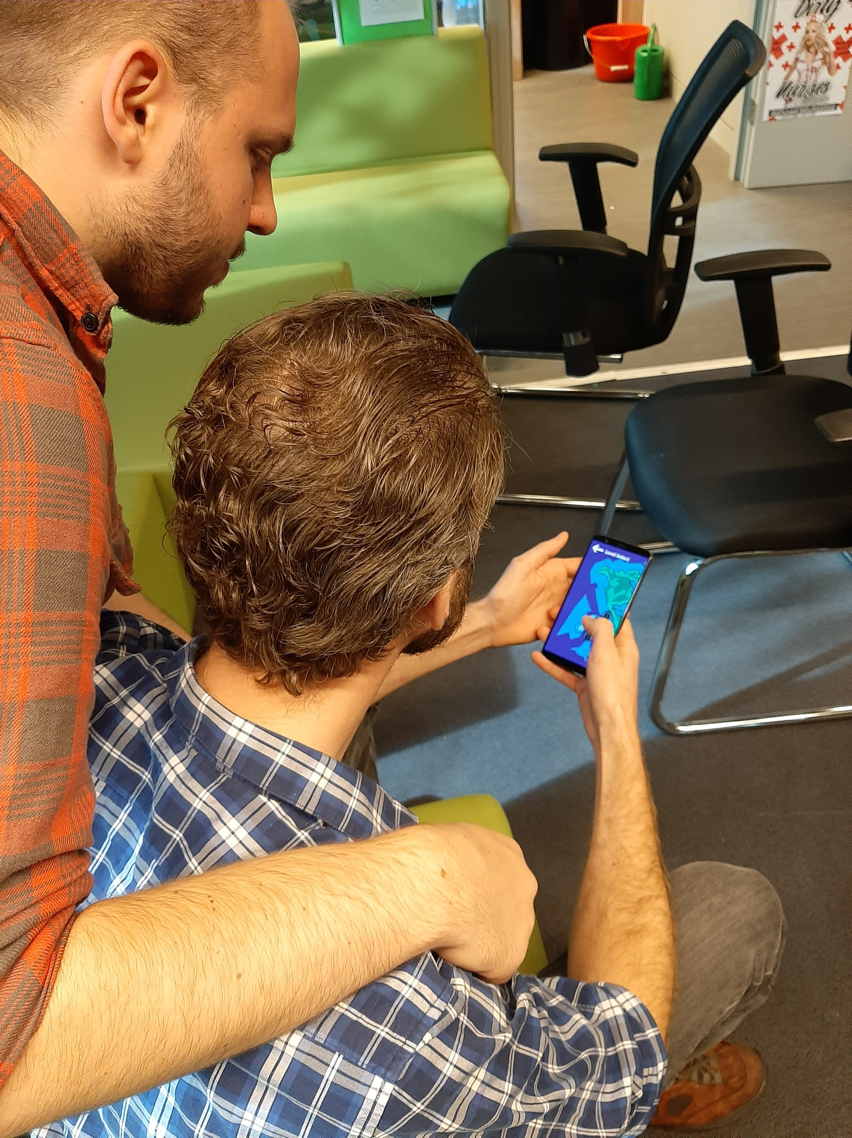
Play the game
Notes:
Play the game for X minutes and then we’ll continue with the planning and the reflection of our presentation

Slide 7
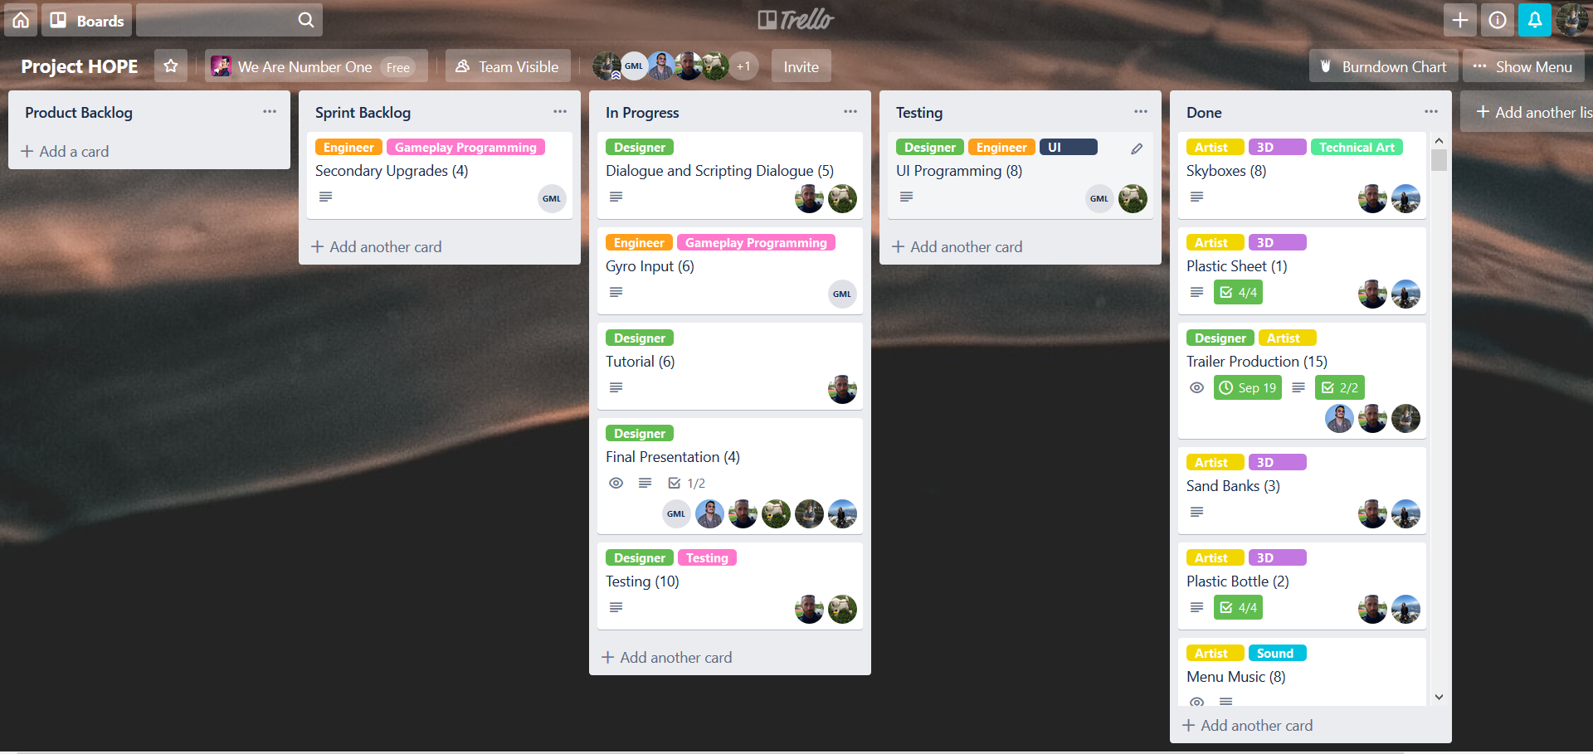
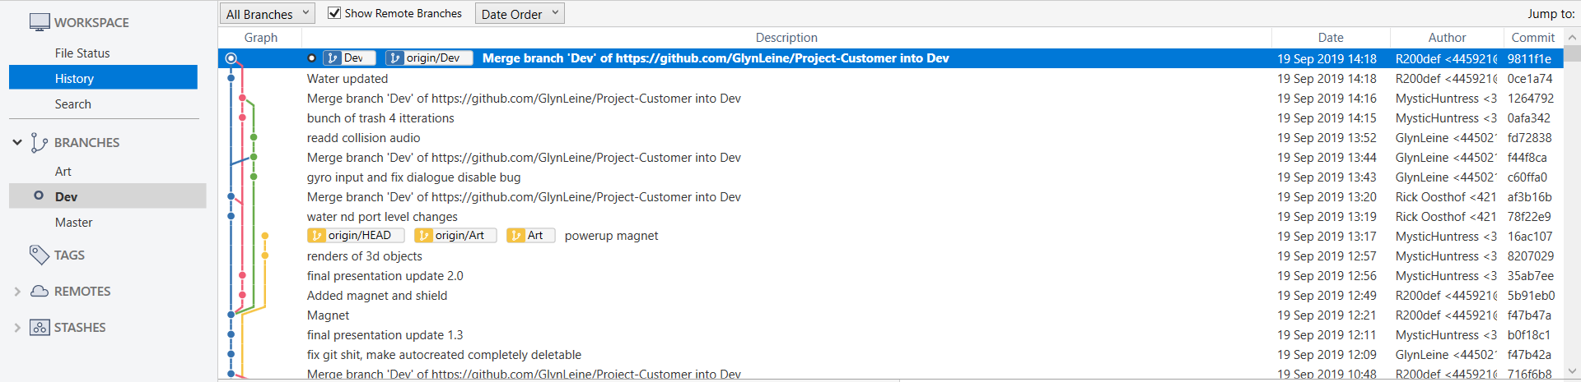
Planning
Communication
Git
Trello
Notes:
What apps did we use, how did our communication go throughout the weeks + trello/git

Slide 8
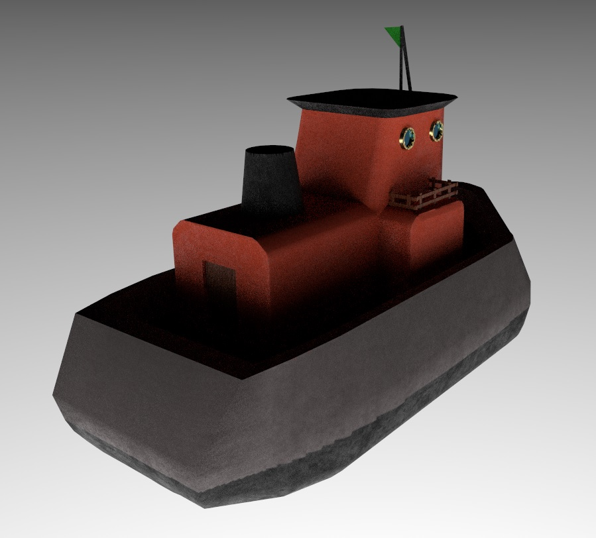
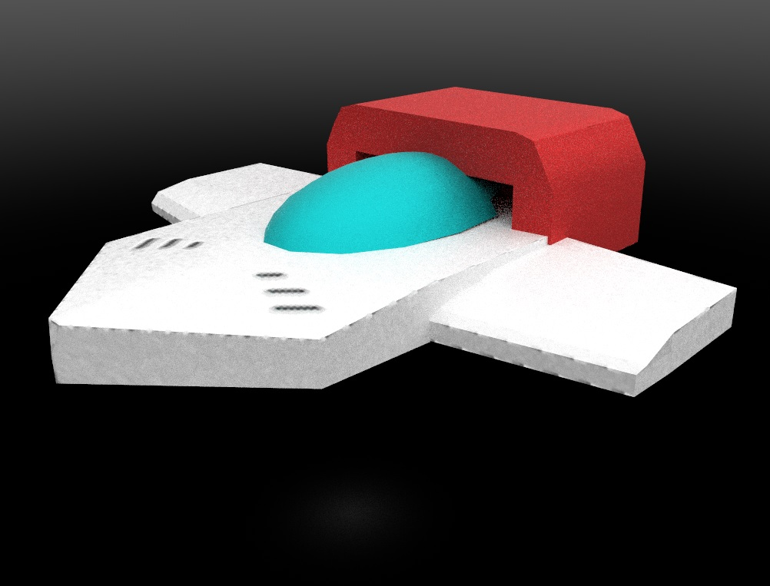
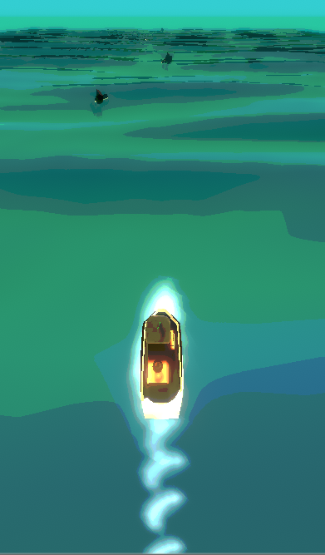
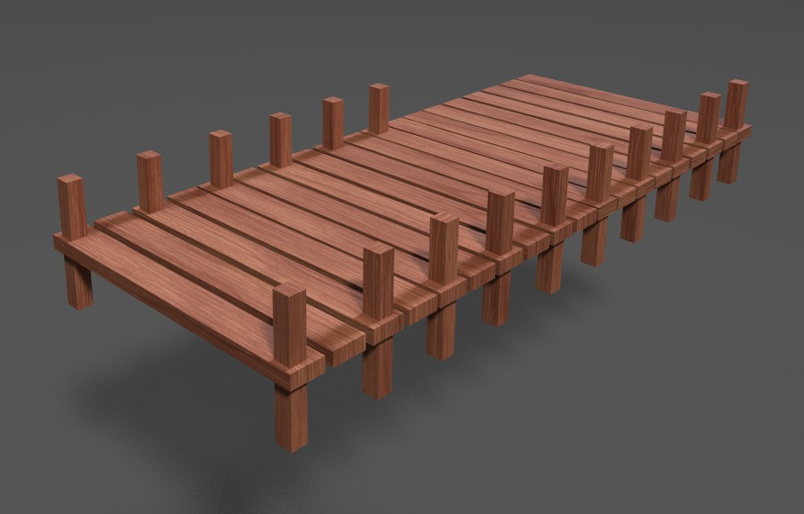
Rob Artist
Shaders
Particles
3D modeling
Project management
Notes:
What did rob do

Slide 9





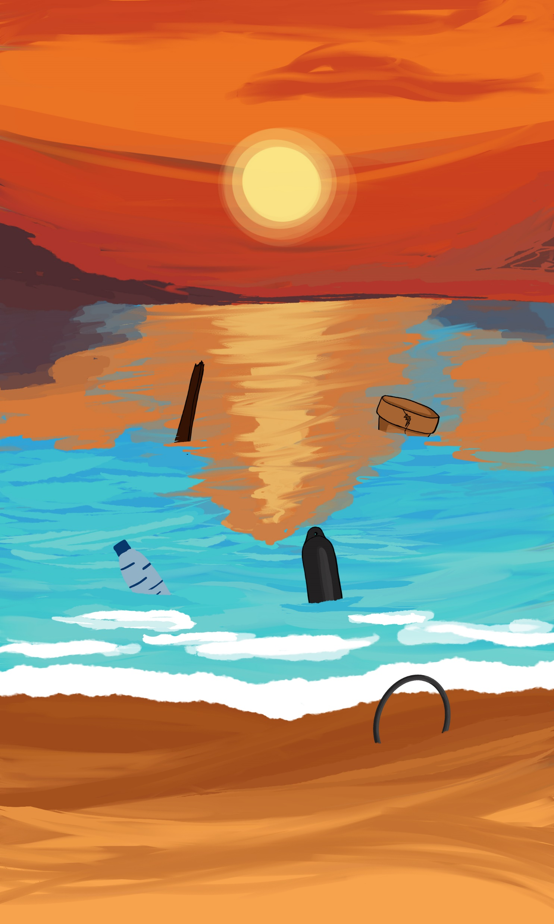

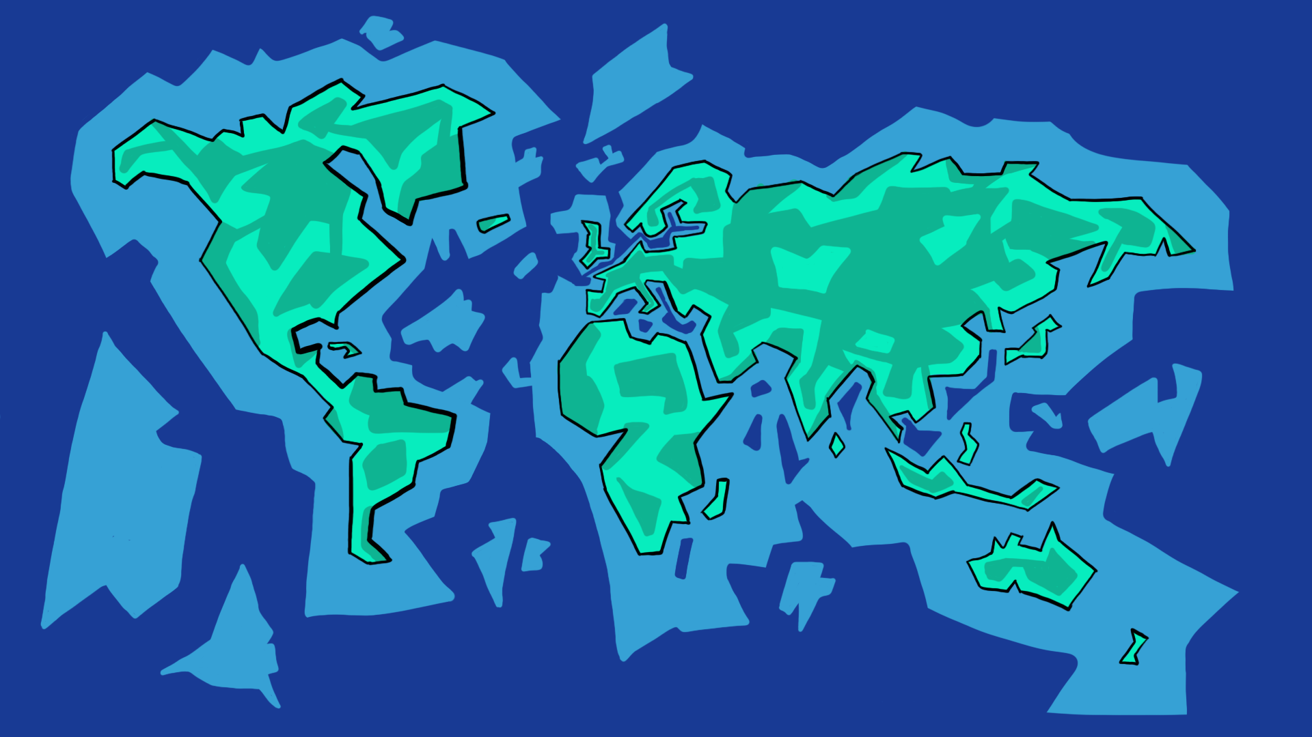

Tamara Artist
Concept art
UI art
UV-mapping and texturing
Skyboxes
Backgrounds start screen
Notes:
Just explain each of the things that you did during the project

Slide 10
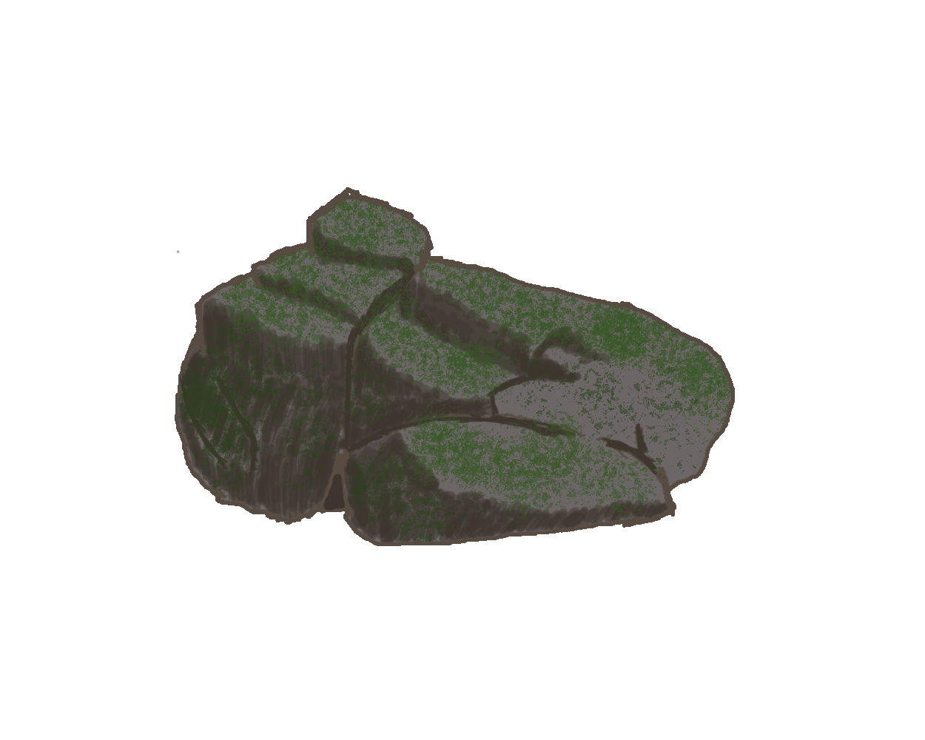
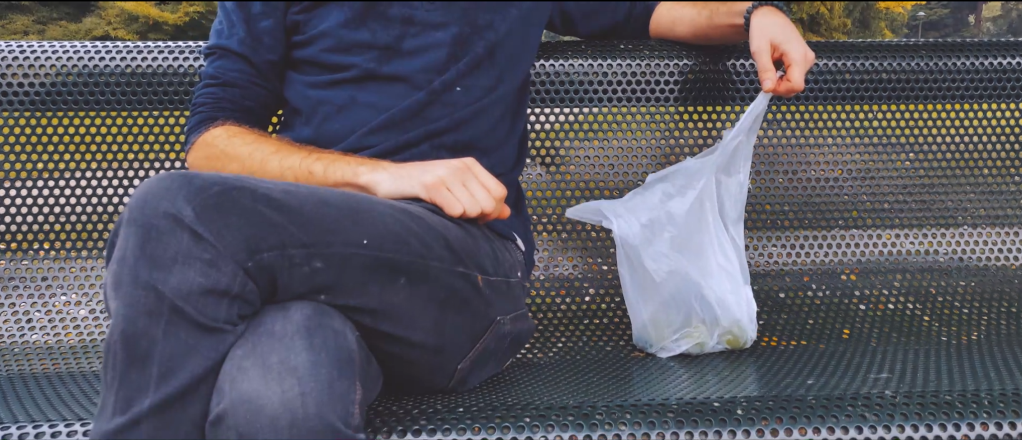


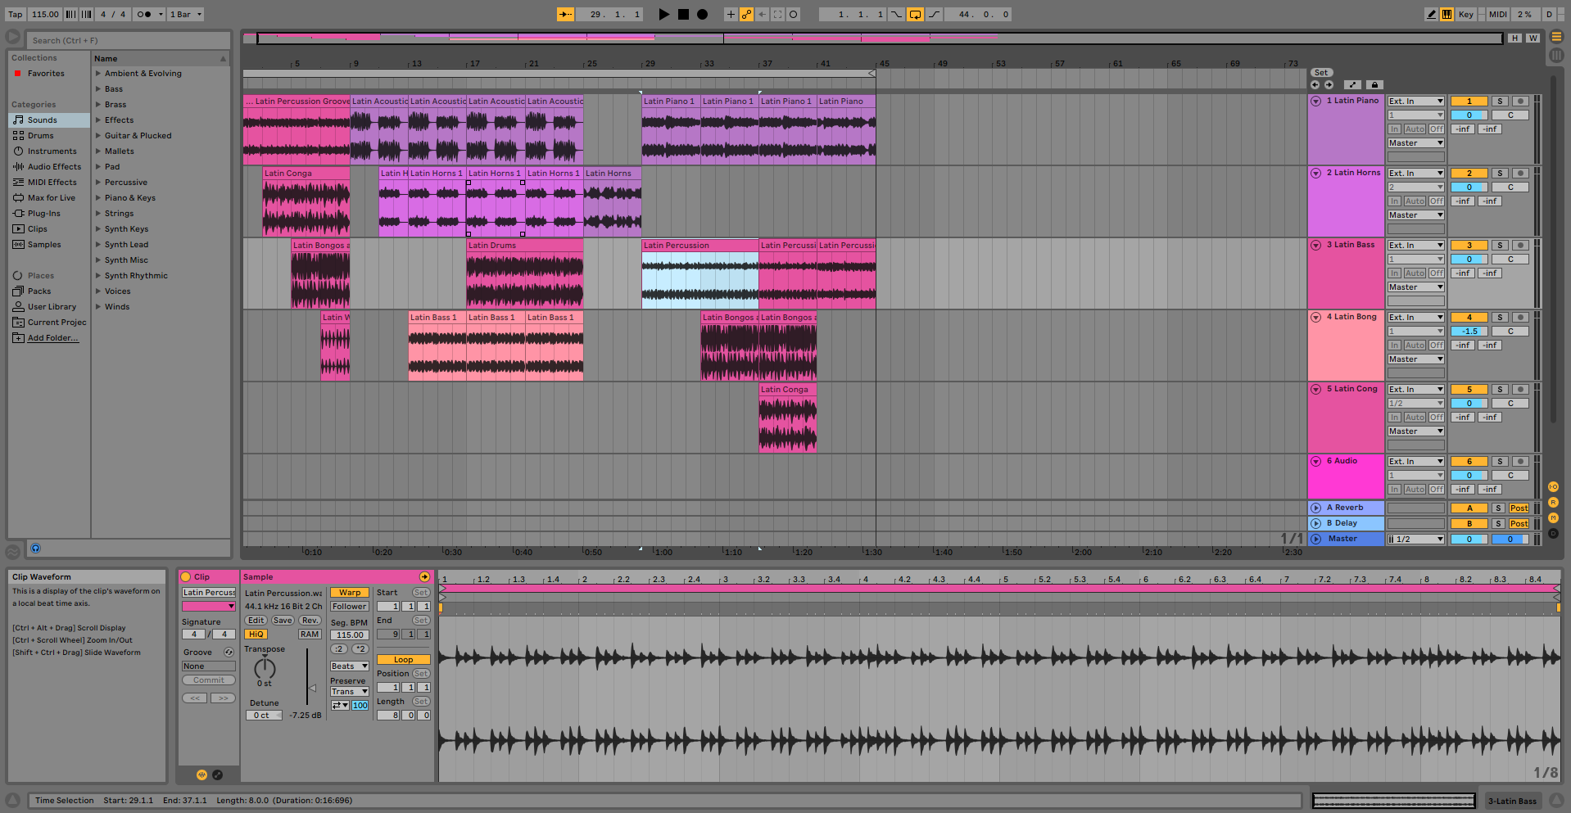
Humam Artist
Concept art
Audio sound effects
Music
Trailer
UI animation
Notes:
humam

Slide 11
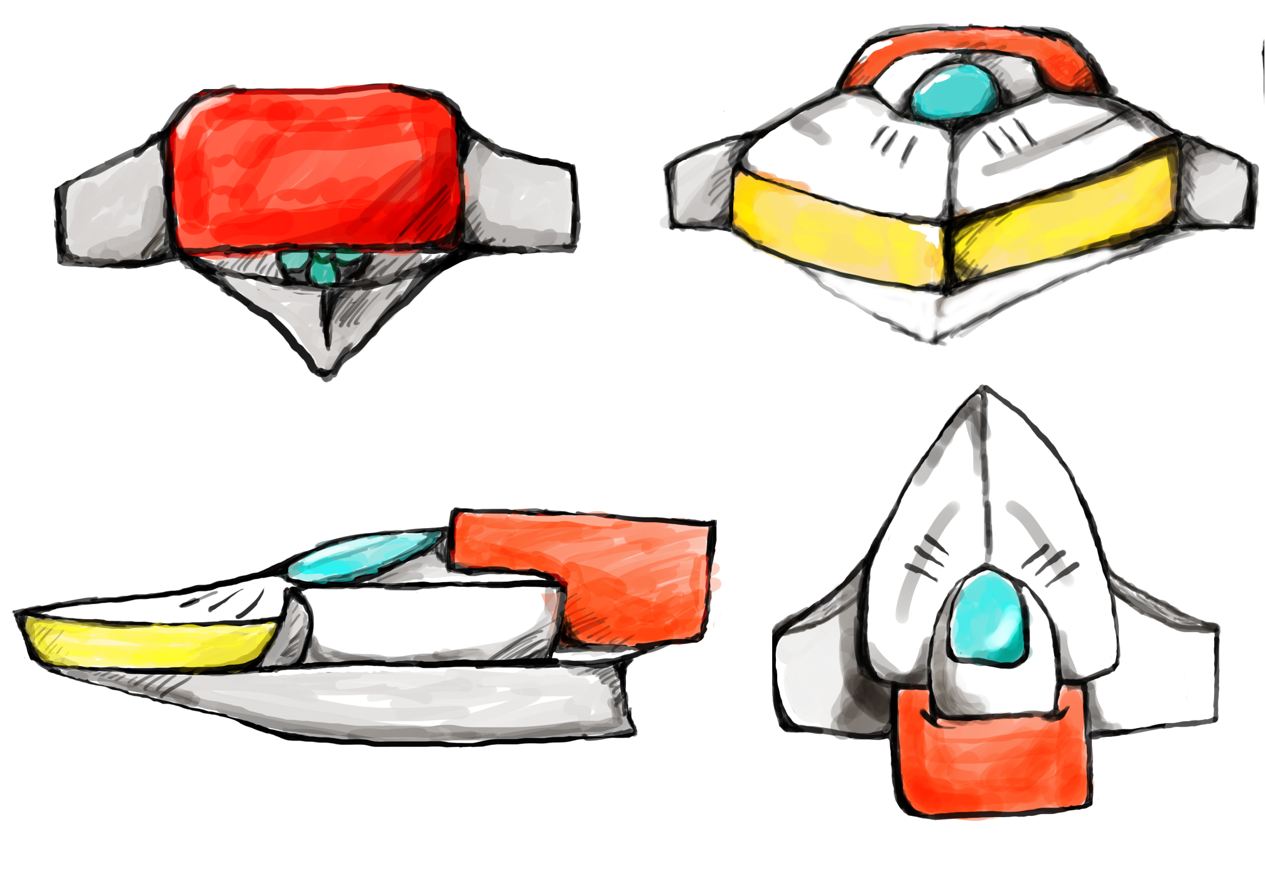
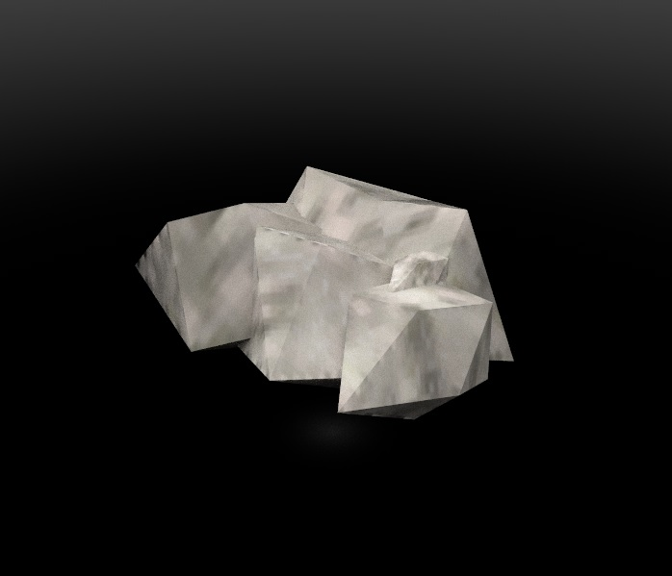
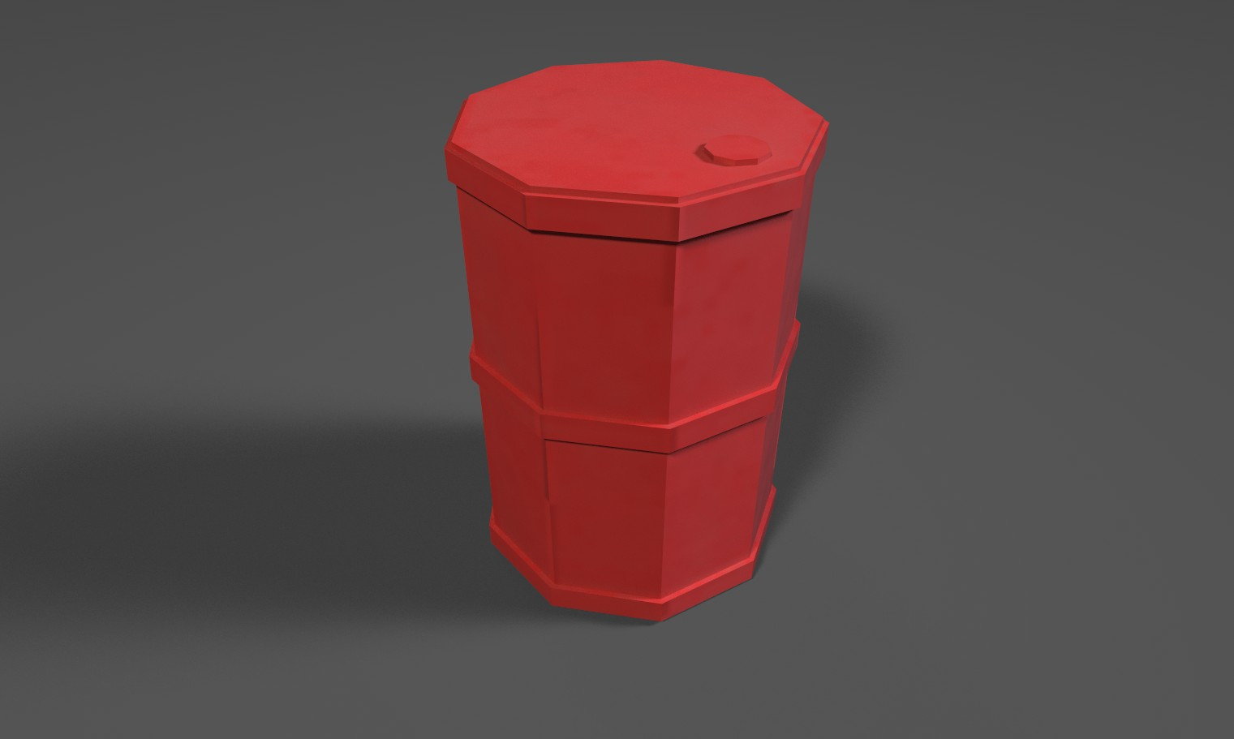
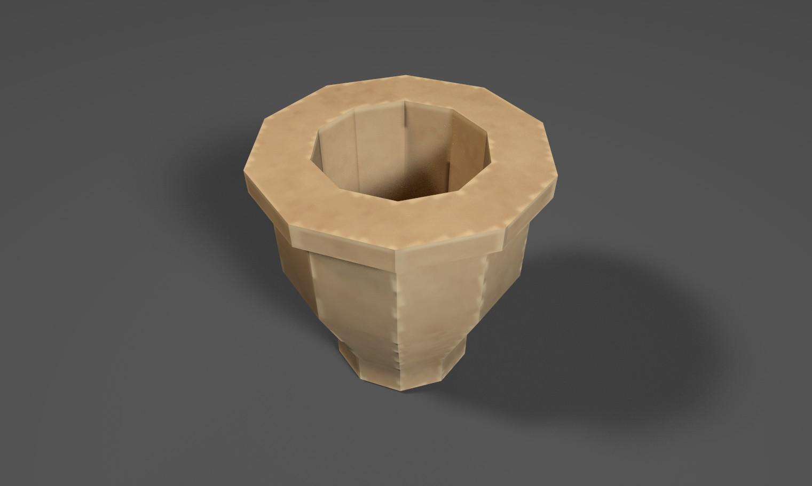
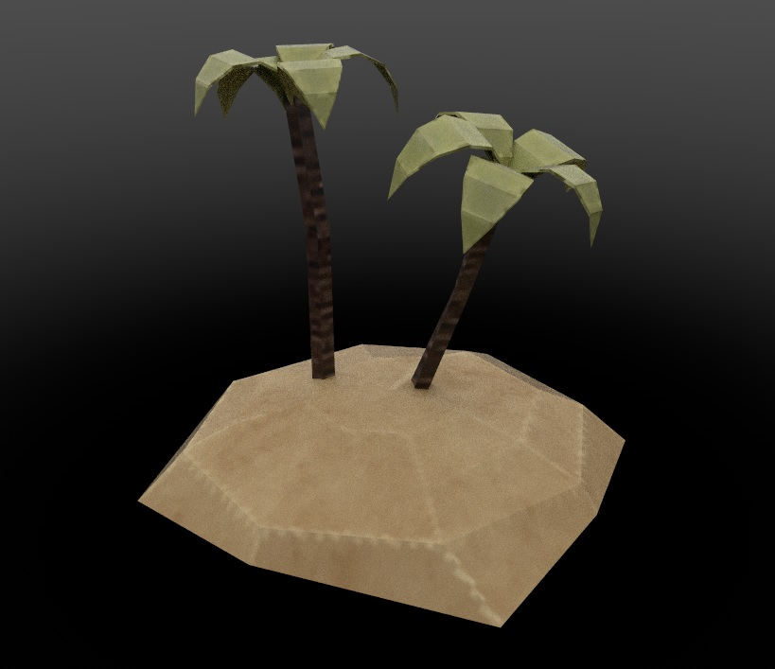

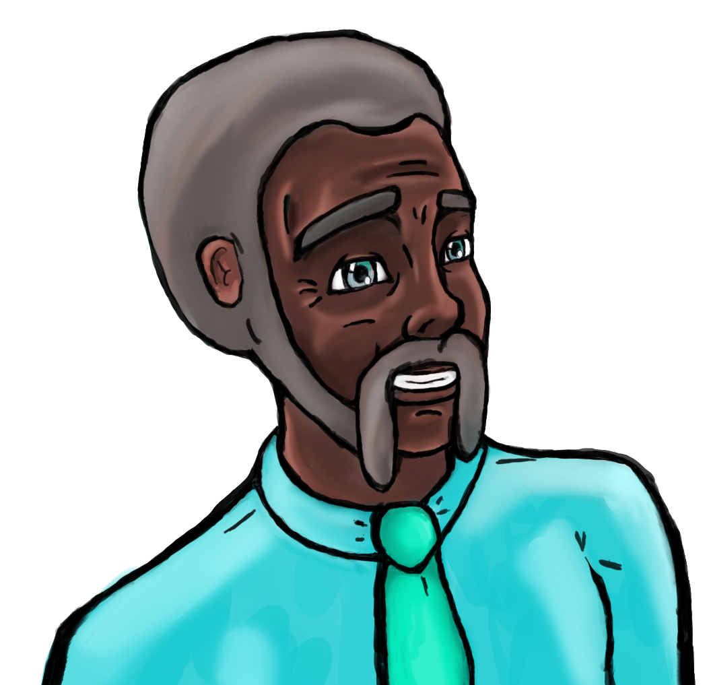
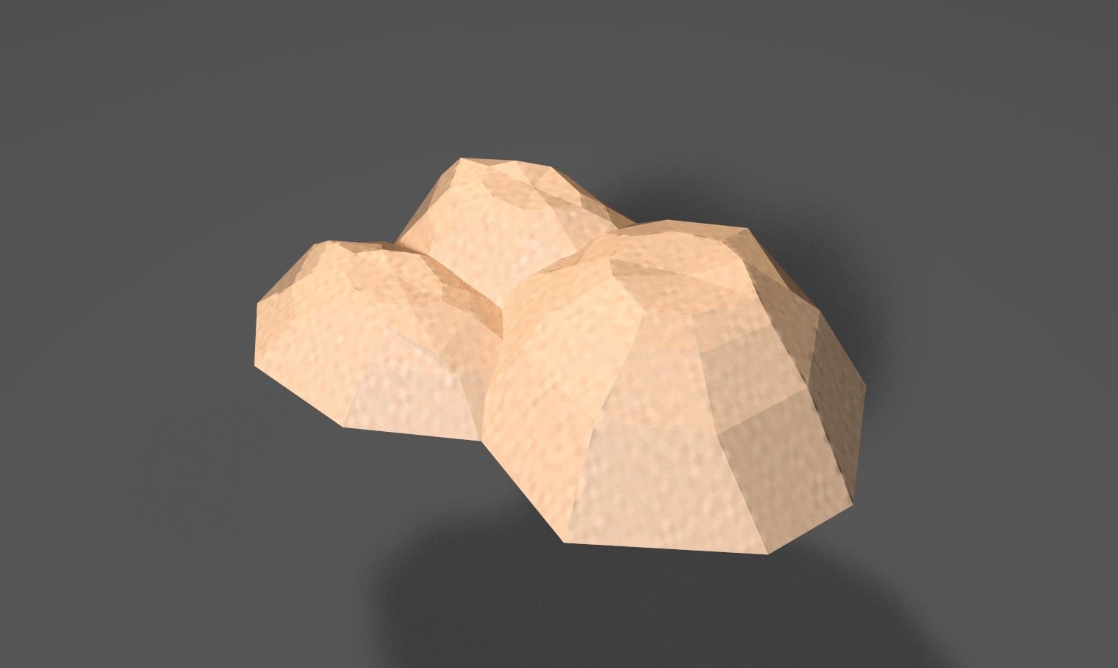
Olivier Designer/Artist
Concepting
3D models
Texturing
Character design
Dialog text
Notes:
olivier

Slide 12

Concept and model
Notes:
Our progress + potentially the pipeline

Slide 13

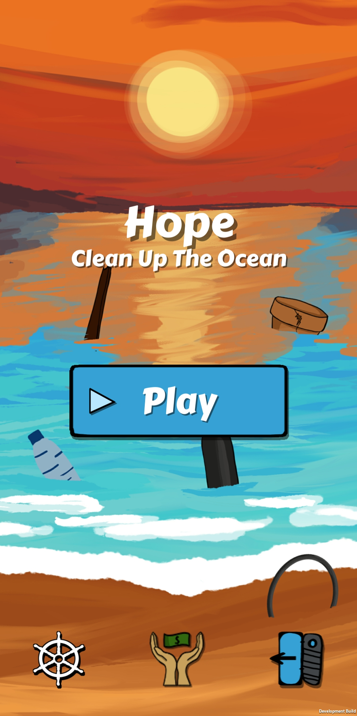
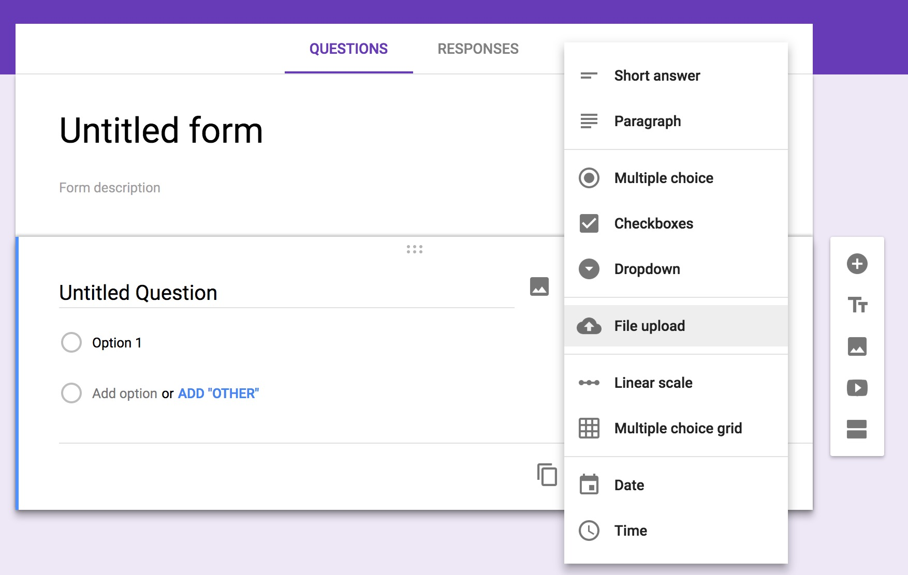

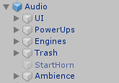
Rick Designer
Research
Game design documentation
UI design
UI programming
Audio programmer
Testing
Notes:
Go over each thing

Slide 14
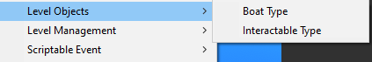
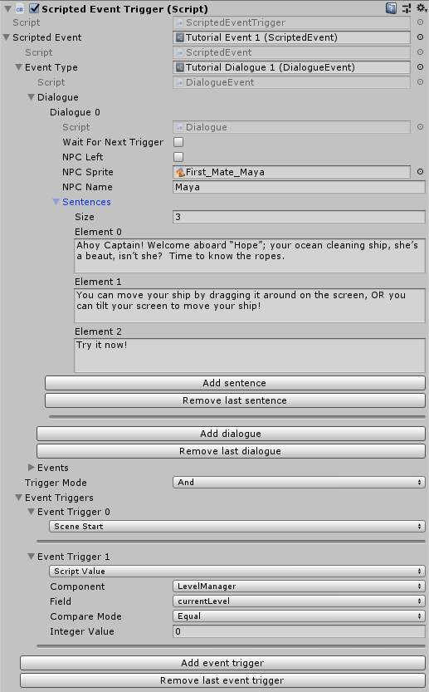
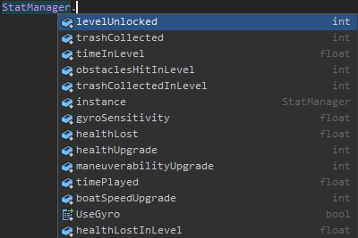
Glyn Programmer
Tools
Gameplay
Notes:
Just explain that you made tools + gameplay, maybe specify what the screenshots are

Slide 15
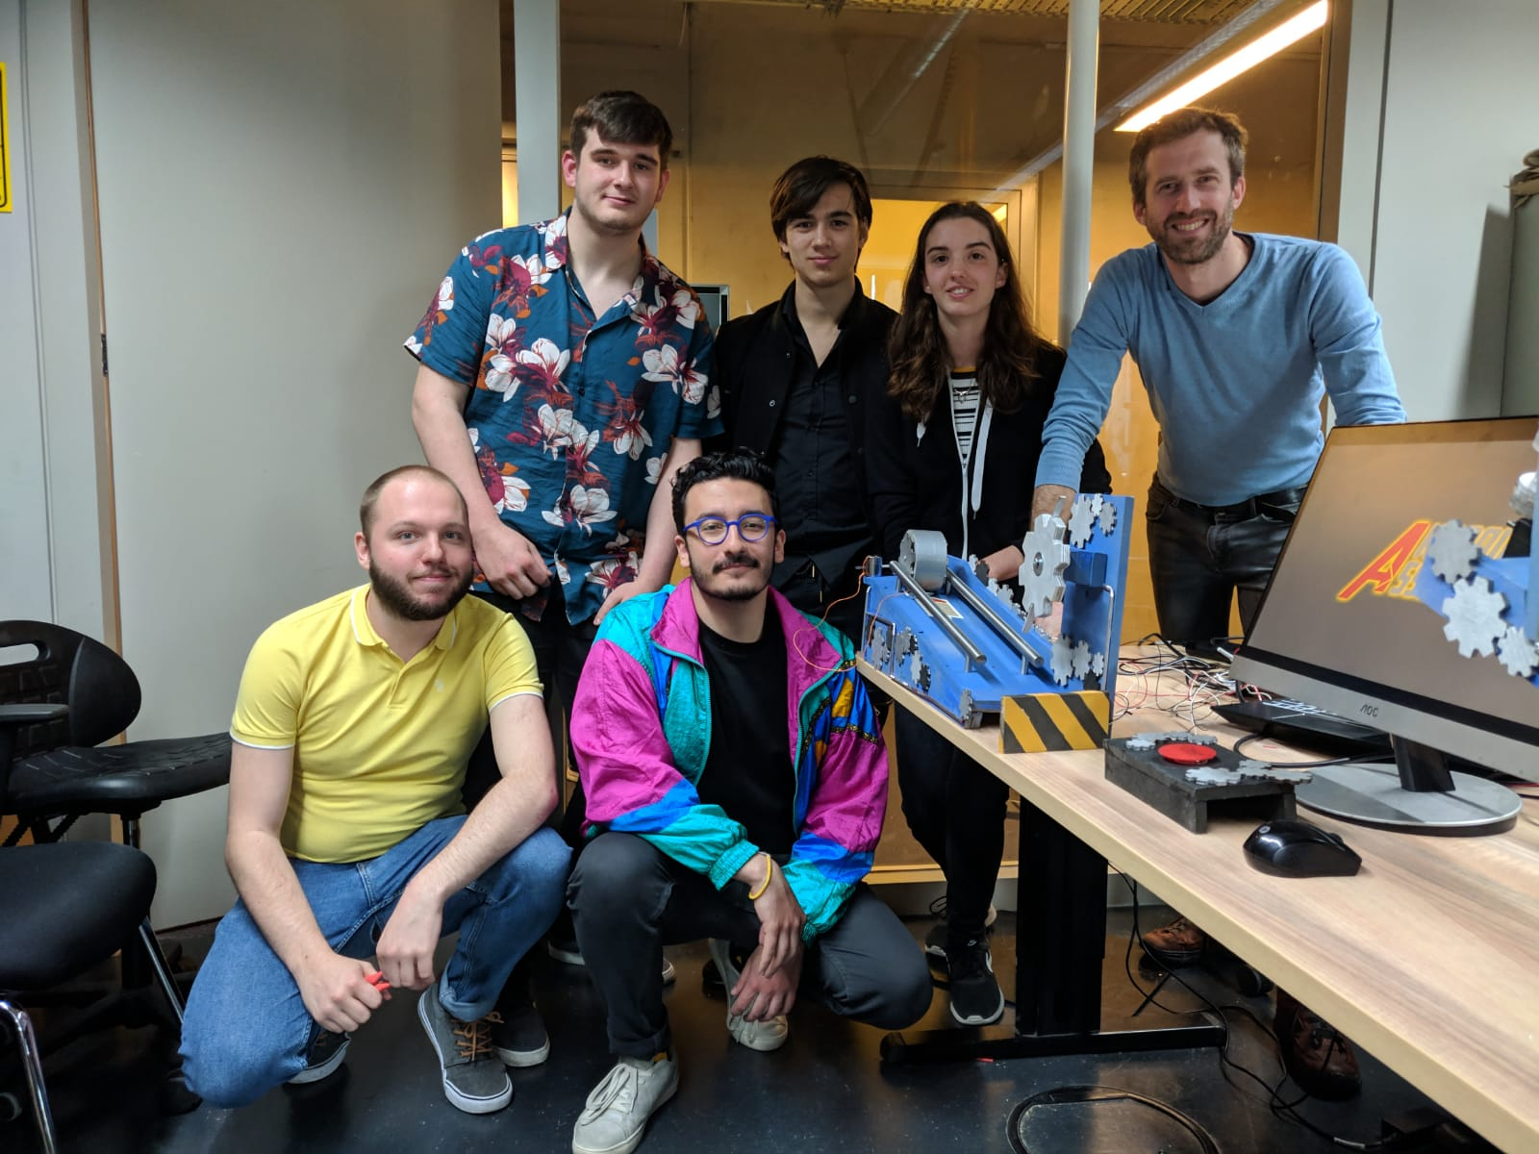
Team Reflection
What went well?
What could we improve?
Green Card: Rick
Notes:
What went well? Esp versus last project(still same team) what can be improved? Why does rick deserve the green card

Slide 16

Thank you for listening!
Any questions?

